Slide 1
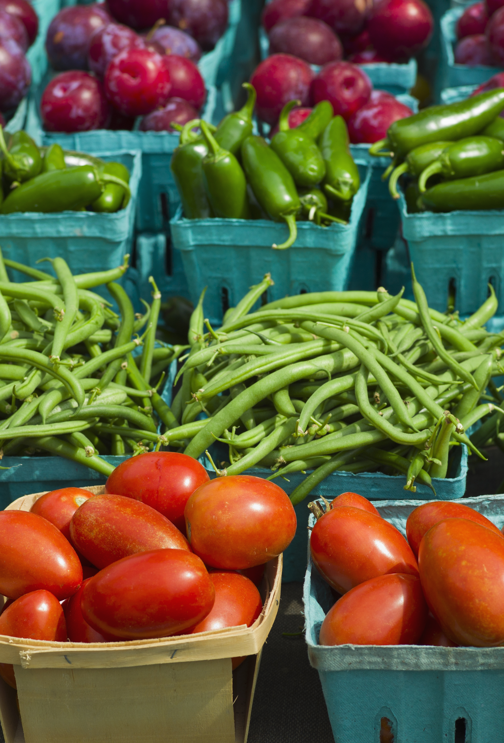
Using Machine Learning to Understand Housing Prices in California with Low Food Access
Yahel, Mhaire, Ryan, Aidan, and Liya

Slide 2

Agenda
Background
Objective & Questions
Methods and Materials
Results
Conclusions & Limitations
Recommendations
Sources

Slide 3
Background
What is a food desert?
“geo­graph­ic areas where res­i­dents have few to no con­ve­nient options for secur­ing afford­able and healthy foods — espe­cial­ly fresh fruits and veg­eta­bles.
Dis­pro­por­tion­ate­ly found in high-pover­ty areas, food deserts cre­ate extra, every­day hur­dles that can make it hard­er for kids, fam­i­lies and com­mu­ni­ties to grow healthy and strong.”
10%of the approximately 65,000 census tracts in the United States are food deserts

Slide 4
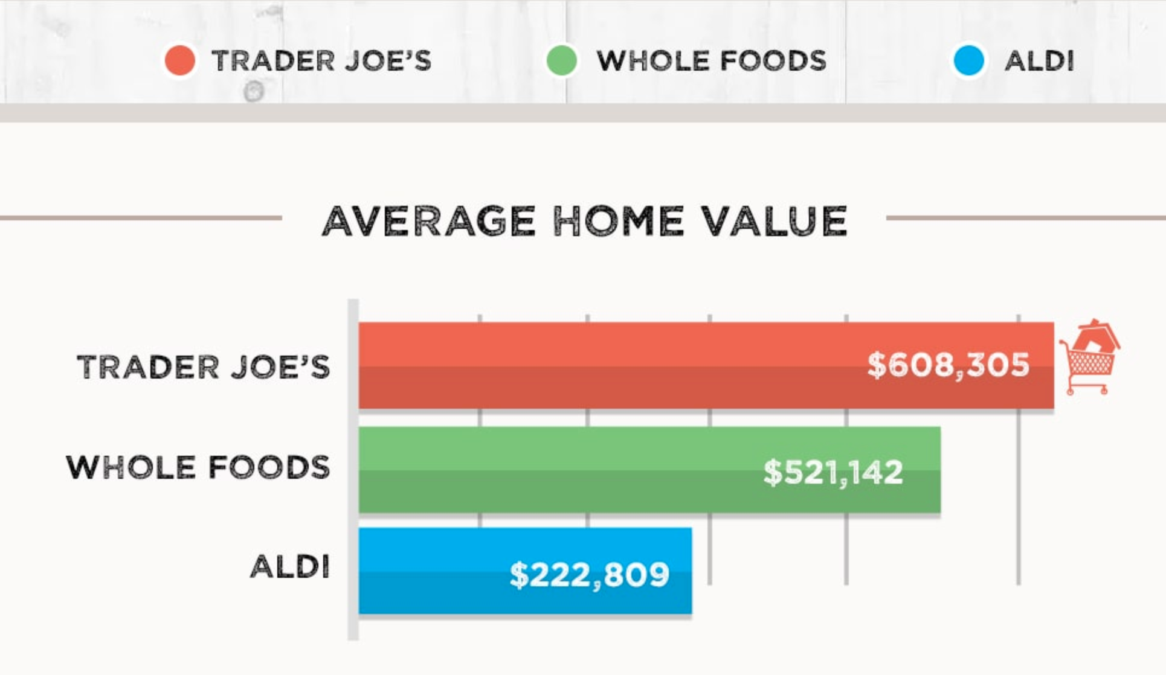
Background
What is the connection between housing prices and food access?
ATTOM Data Solutions analyzed the average home values, 5-year home price appreciation from YTD 2019 vs 2014, etc of 1,859 zip codes nationwide

Slide 5
Objectives
The purpose of the project is to understand the housing prices in California depending on distance to a low access area.

Slide 6
Methods & Materials
Data Acquisition and Cleaning
Google Searches
Web Scraping
Jupyter Notebook/Pandas
Data Management
SQL/SQLite
Machine Learning
Linear Regression

Slide 7
Methods & Materials
Data Points
Census tracts
Distance

Slide 8
Materials

Slide 9

Results

Slide 12
Conclusion & Limitations

Slide 13
Recommendations

Slide 14
Sources
This is how grocery chains affect a home’s value
Does the New Whole Foods in Your Neighborhood Increase Your Home Value?

